Slide 1
ME 203 Introduction to MATLAB
1

Slide 2
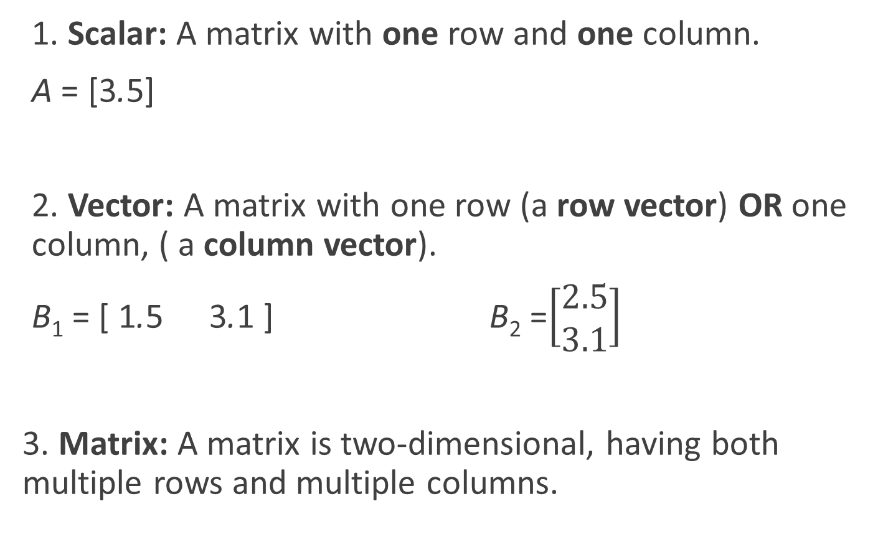
Review of Matrix Definitions
1. Scalar: A matrix with one row and one column.
A = [3.5]
2. Vector: A matrix with one row (a row vector) OR one column, ( a column vector).
B₁ = [ 1.5 3.1 ] B₂ =$\left[\begin{matrix}2.5 \\ 3.1\end{matrix}\right]$
3. Matrix: A matrix is two-dimensional, having both multiple rows and multiple columns.

Slide 3
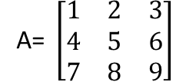
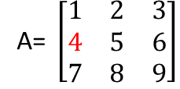
Matrices
Each location in a matrix can be described using a row and a column
a_{ij} is the element of matrix A located in row i and column j
For example, a₂₁=4
Row 2
Column 1

Slide 4
Matrices in MATLAB
In the command window type
>> h = [1 2 3
4 5 6
7 8 9]
h =
1 2 3
4 5 6
7 8 9

Slide 5
Matrices in MATLAB
In the command window or a script file
>> h = [1 2 3; 4 5 6; 7 8 9]
h =
1 2 3
4 5 6
7 8 9
To find the value in row 2 and column 3 use:
variable(row,column)=value
>>h(2,3)
ans=
6

Slide 6
Matrix Addressing
To extract multiple values from the matrix (create a submatrix) use a colon to specify the range
>> h(1:2,1:3)
ans =
1 2 3
4 5 6
A colon without a range refers to the all rows or all columns
>> h(1:2,:)
ans =
1 2 3
4 5 6
Rows 1 to 2, columns 1 to 3
Rows 1 to 2, all columns

Slide 7
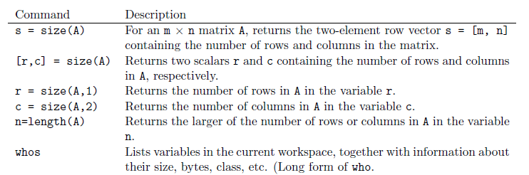
Matrix size

Slide 8
Matrix size
Examples:
>> A = [1 2 3; 4 5 6];
A =
1 2 3
4 5 6
>> s = size(A)
s =
2 3

Slide 9
Matrix size
>> [r,c] = size(A)
r =
2
c =
3
>> r = size(A,1)
r =
2
>> c = size(A,2)
c =
3

Slide 10
Transpose
The transpose switches rows and columns
>> x = 0:4
x =
0 1 2 3 4
>> x'
ans =
0
1
2
3
4

Slide 11
Tables
Tables of data can be created using the transpose function
>> x = 0:4;
>> y = 5:5:25;
>> A = [x’ y’]
A =
0 5
1 10
2 15
3 20
4 25

Slide 12
Scalar-Array Mathematics
To perform addition, subtraction, multiplication, and division of an array by a scalar simply apply the operation to all elements of the array
>> f = [1 2 3; 4 5 6]
f =
1 2 3
4 5 6
>> g = 2*f -1
g =
1 3 5
7 9 11

Slide 13

Element-by-Element (Array-Array) Multiplication
$A=\left[\begin{matrix}a_{11} & a_{12} & a_{13} \\ a_{21} & a_{22} & a_{23}\end{matrix}\right]$ $B=\left[\begin{matrix}b_{11} & b_{12} & b_{13} \\ b_{21} & b_{22} & b_{23}\end{matrix}\right]$
Size of A = 2 x 3 Size of B = 2 x 3
C = A.*B
size of C = 2 x 3
$C=\left[\begin{matrix}a_{11}b_{11} & a_{12}b_{12} & a_{13}b_{13} \\ a_{21}b_{21} & a_{22}b_{22} & a_{23}b_{23}\end{matrix}\right]$

Slide 14
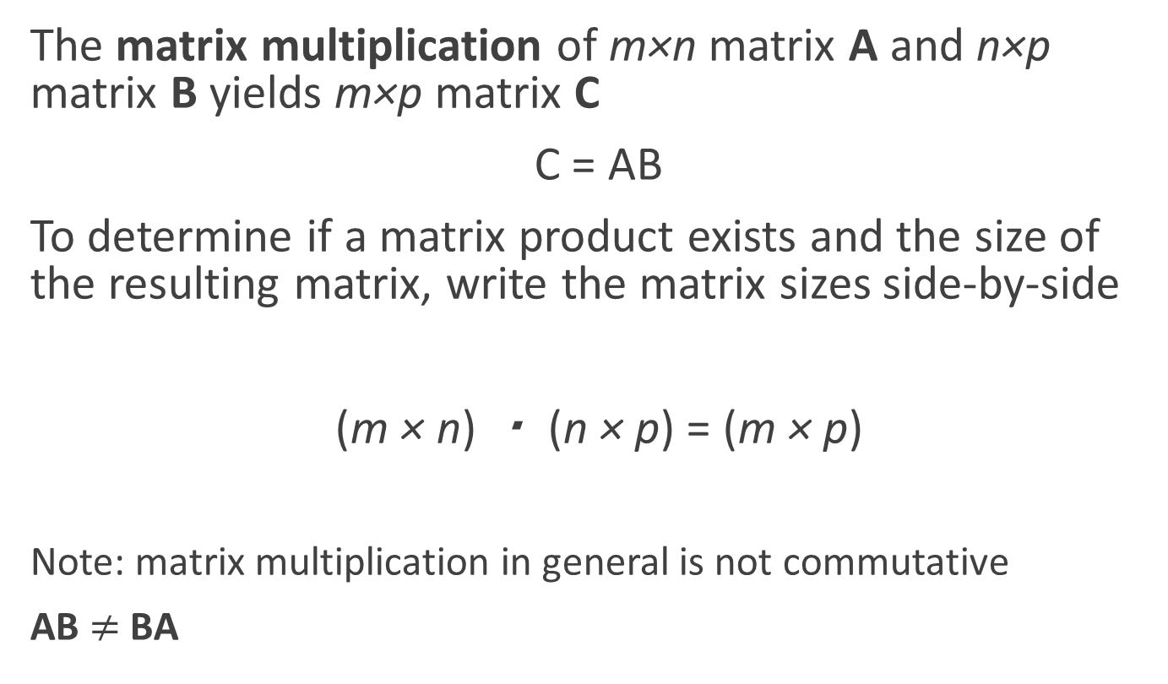
Matrix Multiplication
The matrix multiplication of m×n matrix A and n×p matrix B yields m×p matrix C
C = AB
To determine if a matrix product exists and the size of the resulting matrix, write the matrix sizes side-by-side
(m × n) ・ (n × p) = (m × p)
Note: matrix multiplication in general is not commutative
AB $≠$ BA

Slide 15
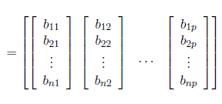
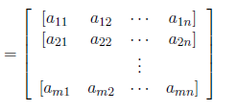

Matrix Multiplication
The matrix multiplication of m×n matrix A and n×p matrix B yields m×p matrix C
C = AB
Element c_{ij} is the inner product of row i of A and column j of B
A= B=

Slide 16
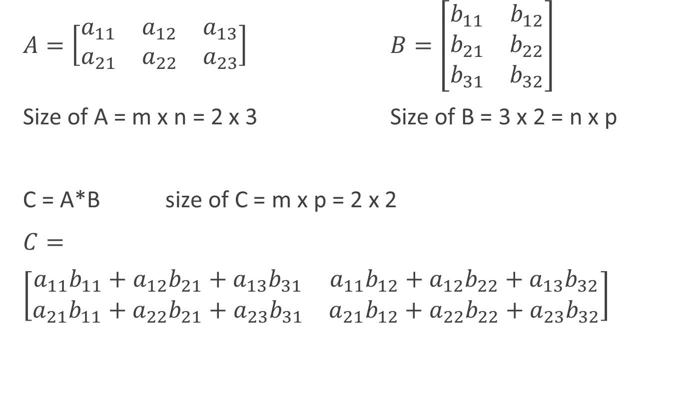
Matrix Multiplication
$A=\left[\begin{matrix}a_{11} & a_{12} & a_{13} \\ a_{21} & a_{22} & a_{23}\end{matrix}\right]$ $B=\left[\begin{matrix}b_{11} & b_{12} \\ b_{21} & b_{22} \\ b_{31} & b_{32}\end{matrix}\right]$
Size of A = m x n = 2 x 3 Size of B = 3 x 2 = n x p
C = A*B size of C = m x p = 2 x 2
$C=$
$\left[\begin{matrix}a_{11}b_{11}+a_{12}b_{21}+a_{13}b_{31} & a_{11}b_{12}+a_{12}b_{22}+a_{13}b_{32} \\ a_{21}b_{11}+a_{22}b_{21}+a_{23}b_{31} & a_{21}b_{12}+a_{22}b_{22}+a_{23}b_{32}\end{matrix}\right]$

Slide 17
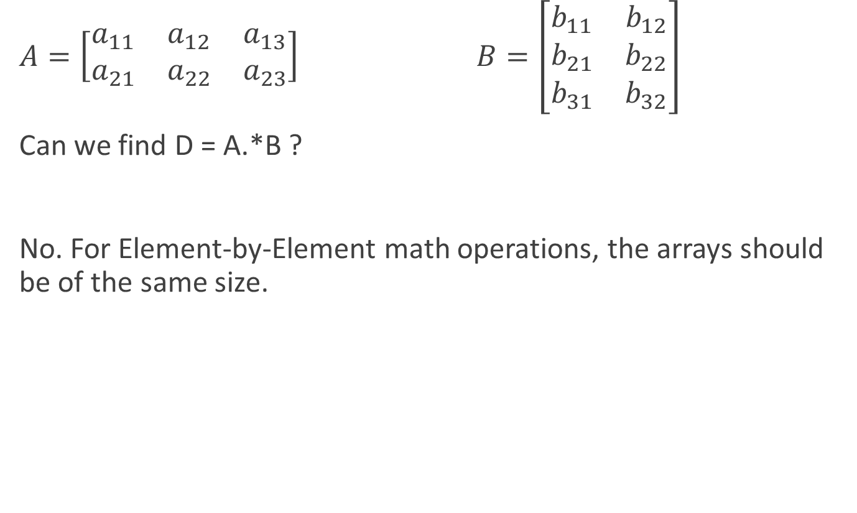
Note:
$A=\left[\begin{matrix}a_{11} & a_{12} & a_{13} \\ a_{21} & a_{22} & a_{23}\end{matrix}\right]$ $B=\left[\begin{matrix}b_{11} & b_{12} \\ b_{21} & b_{22} \\ b_{31} & b_{32}\end{matrix}\right]$
Can we find D = A.*B ?
No. For Element-by-Element math operations, the arrays should be of the same size.

Slide 18


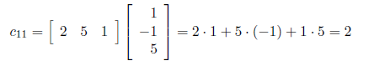
Matrix Multiplication
Example
Repeat for the rest of the elements

Slide 19
Matrix Multiplication in MATLAB
>>A = [2,5,1; 0,3,-1]
A =
2 5 1
0 3 -1
>>B = [1,0,2; -1,4,-2; 5,2,1]
B =
1 0 2
-1 4 -2
5 2 1
>> C = A*B
C =
2 22 -5
-8 10 -7
>> C = B*A
Error using *
Inner matrix dimensions must agree.

Slide 20
Special Matrices
Create a matrix of ones
>> ones(3)
ans =
1 1 1
1 1 1
1 1 1
>>ones(2,3)
ans =
1 1 1
1 1 1

Slide 21
Special Matrices
Create a matrix of zeros
>> zeros(3)
ans =
0 0 0
0 0 0
0 0 0
>> zeros(3,2)
ans =
0 0
0 0
0 0

Slide 22
Special Matrices
Identity matrix
>> eye(3)
ans =
1 0 0
0 1 0
0 0 1
3x3 identity matrix
>> eye(2,3)
ans =
1 0 0
0 1 0
matrix with 1's on the diagonal and zeros elsewhere

Slide 23
Special Matrices
A tri-diagonal matrix only has values on the main diagonal and the diagonal on either side
To create a matrix like this there is not a built-in function
Use equations to specify the values that are not zeros
1 2 0 0 0
3 1 2 0 0
0 3 1 2 0
0 0 3 1 2
0 0 0 3 1

Slide 24
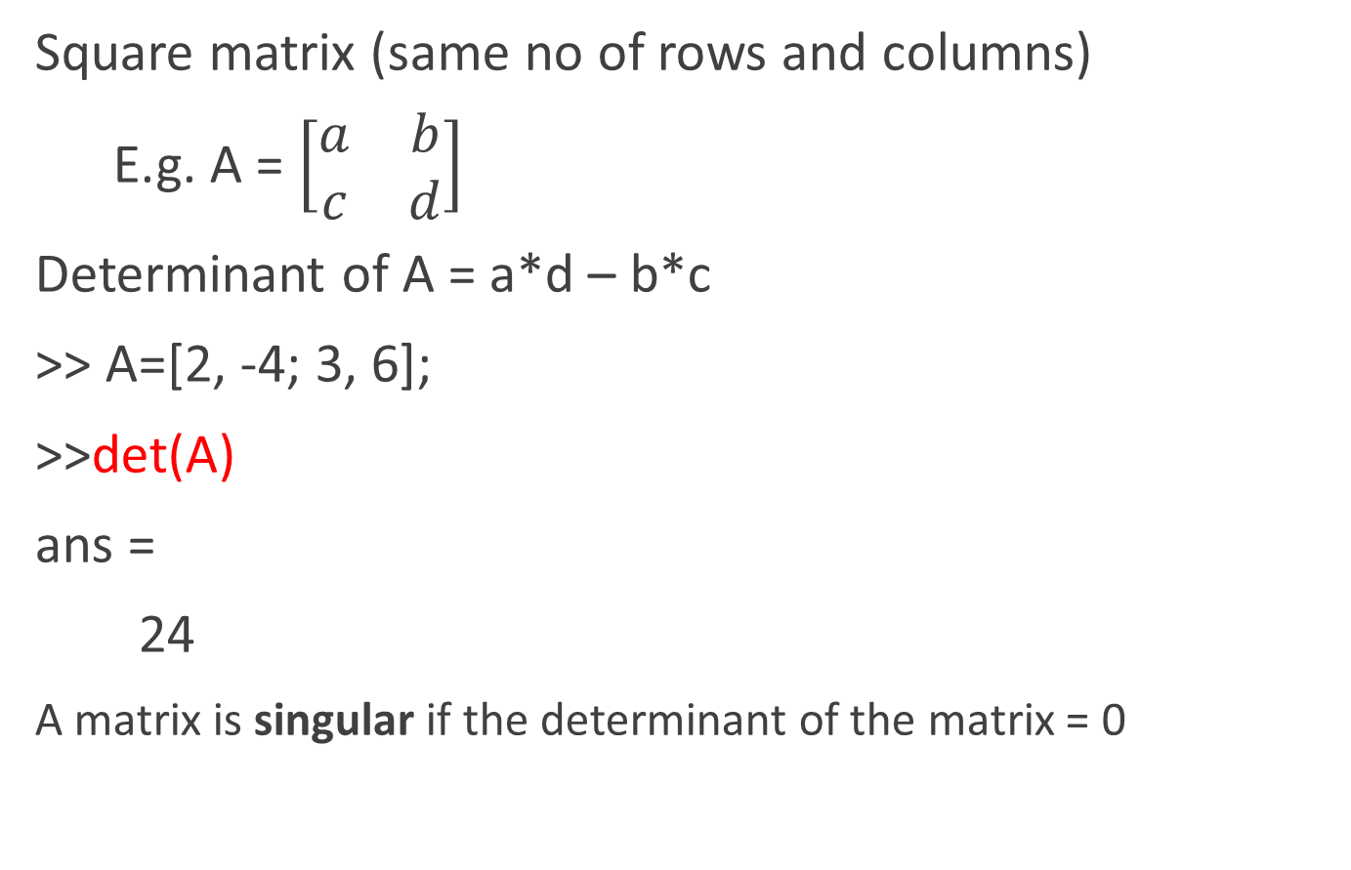
Determinant of a Square Matrix
Square matrix (same no of rows and columns)
E.g. A = $\left[\begin{matrix}a & b \\ c & d\end{matrix}\right]$
Determinant of A = a*d – b*c
>> A=[2, -4; 3, 6];
>>det(A)
ans =
24
A matrix is singular if the determinant of the matrix = 0

Slide 25
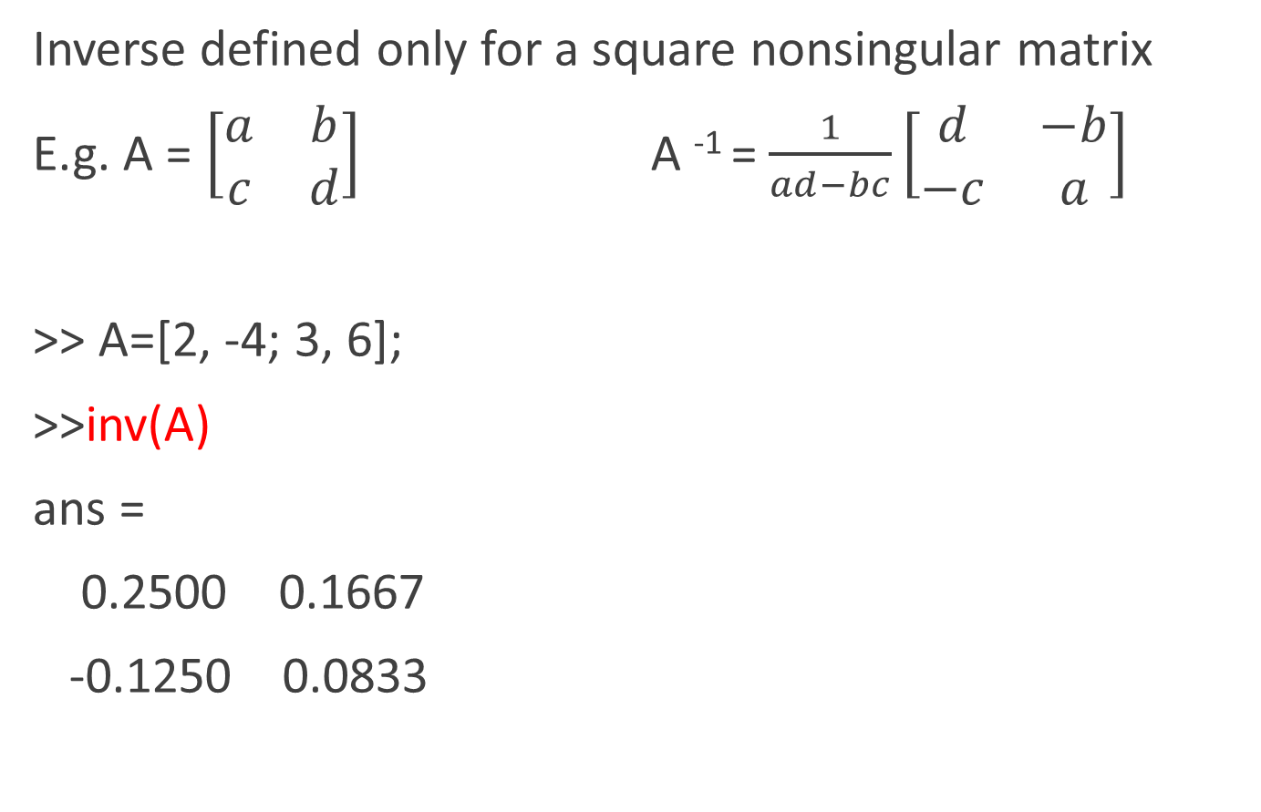
Inverse of a Square Matrix
Inverse defined only for a square nonsingular matrix
E.g. A = $\left[\begin{matrix}a & b \\ c & d\end{matrix}\right]$ A ⁻¹ = $\frac{1}{ad−bc}\left[\begin{matrix}d & −b \\ −c & a\end{matrix}\right]$
>> A=[2, -4; 3, 6];
>>inv(A)
ans =
0.2500 0.1667
-0.1250 0.0833

Slide 26
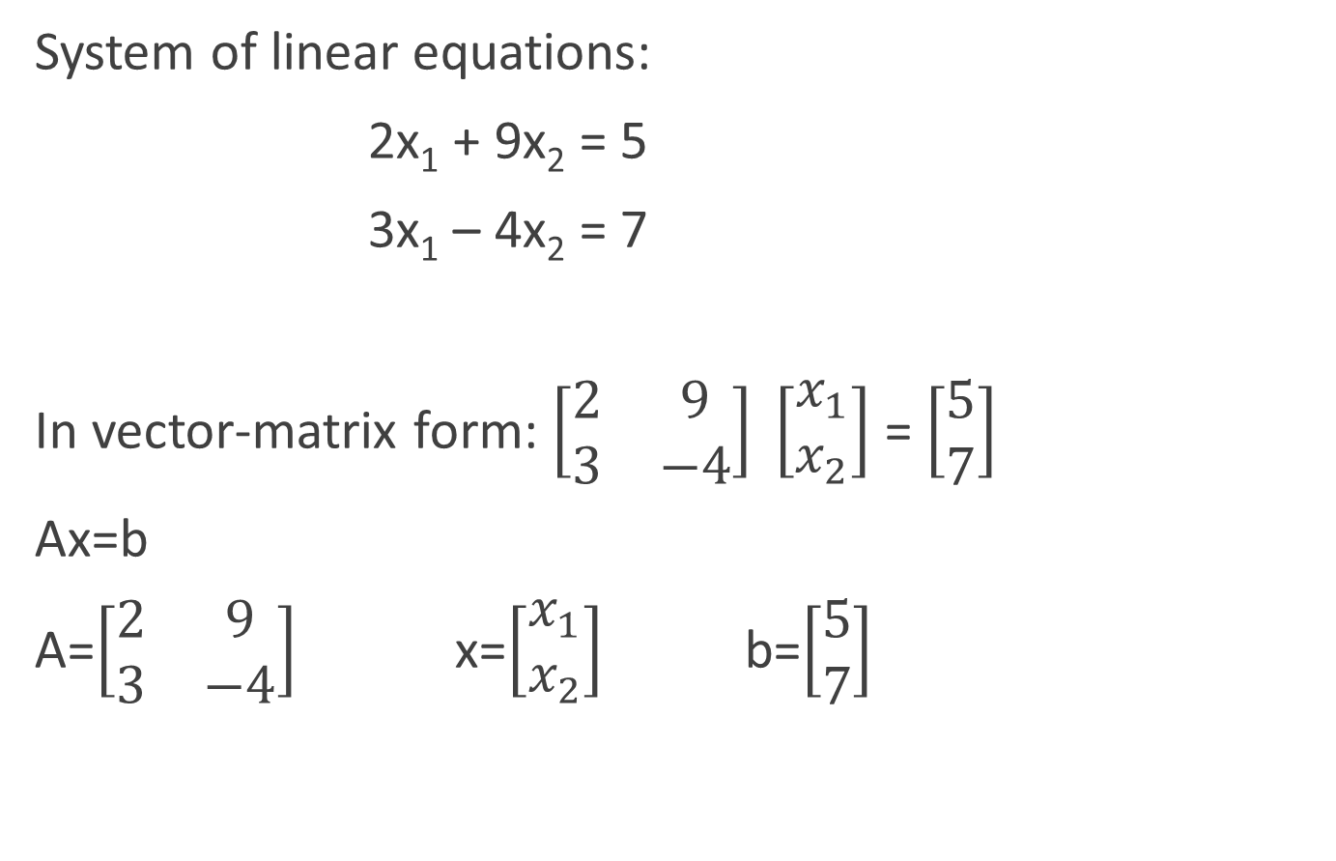
Matrix methods for linear equations
System of linear equations:
2x₁ + 9x₂ = 5
3x₁ – 4x₂ = 7
In vector-matrix form: $\left[\begin{matrix}2 & 9 \\ 3 & −4\end{matrix}\right] \left[\begin{matrix}x_{1} \\ x_{2}\end{matrix}\right]$ = $\left[\begin{matrix}5 \\ 7\end{matrix}\right]$
Ax=b
A=$\left[\begin{matrix}2 & 9 \\ 3 & −4\end{matrix}\right]$ x=$\left[\begin{matrix}x_{1} \\ x_{2}\end{matrix}\right]$ b=$\left[\begin{matrix}5 \\ 7\end{matrix}\right]$

Slide 27

Matrix methods for linear equations
Matrix inverse method
A=$\left[\begin{matrix}2 & 9 \\ 3 & −4\end{matrix}\right]$ x=$\left[\begin{matrix}x_{1} \\ x_{2}\end{matrix}\right]$ b=$\left[\begin{matrix}5 \\ 7\end{matrix}\right]$
>> A = [2, 9; 3, -4];
>> b = [5; 7];
>> x = inv(A) * b
x =
2.3714
0.0286
Solutions
x₁ = 2.3714
x₂ = 0.0286

Slide 28

Matrix methods for linear equations
Left division method
A=$\left[\begin{matrix}2 & 9 \\ 3 & −4\end{matrix}\right]$ x=$\left[\begin{matrix}x_{1} \\ x_{2}\end{matrix}\right]$ b=$\left[\begin{matrix}5 \\ 7\end{matrix}\right]$
>> A = [2, 9; 3, -4];
>> b = [5; 7];
>> x = A\ b
x =
2.3714
0.0286
Left division
Solutions
x₁ = 2.3714
x₂ = 0.0286
Notes:
2x – y = 10
–x + 2y – z = 0
–y + z = –50

Slide 29
Matrix example
Given H = [1,2,3,4;5,6,7,8;9,10,11,12;13,14,15,16]
Define g as the transpose of the center of matrix H
Define f to be the size of g using first row of H
Define d as the element-by-element multiplication of g and f
Define square matrix q as the last column of H
Define j as d^q

Slide 30
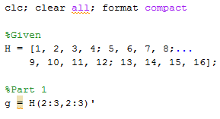

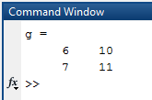
Matrix example
1. Define g as the transpose of the center of matrix H
Result

Slide 31

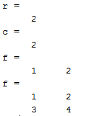


Matrix example
2. Define f to be the size of g using first row of H
Result
Result

Slide 32


Matrix example
3. Define d as the element-by-element multiplication of
g and f
Result

Slide 33


Matrix example
4. Define square matrix q as the last column of H
Result

Slide 34


Matrix example
5. Define j as d^q
Result

Slide 35
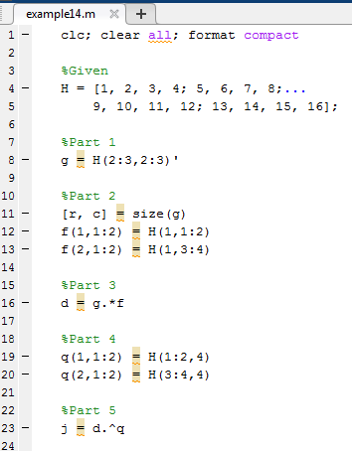
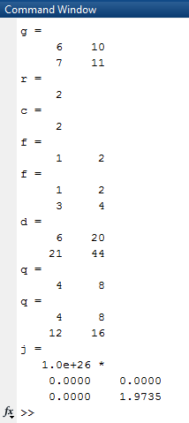
Matrix example

